Slide 1
Predicting Hotel Cancellations
A Supervised Learning Capstone
By Lawrence Quesada

Slide 2
Contents
Dataset
Exploratory Data Analysis
Preparing the Dataset
Model Selection and Results
Tuning the best models / Final Results
Summary
Target Audience
Future Considerations

Slide 3

The dataset
https://www.kaggle.com/jessemostipak/hotel-booking-demand
Original Source:
https://www.sciencedirect.com/science/article/pii/S2352340918315191
Authors: Nuno Antonio, Ana de Almeida and Luis Nunes
Publication Date: February 2019
Notes:
Consider talking about:
International luxury
Lifestyle luxury resorts
Upscale full-service
Boutique
Focused or select service
Economy and limited service
Extended stay
Timeshare and destination clubs
Motel
Microstay

Slide 4
Exploratory Data Analysis
Features: 32
Observations: 119, 390
The percentage who did NOT CANCEL are 63 %
The percentage which CANCELED are 37 %
The percentage of Resort Hotels are 33 %
The percentage of City Hotels are 67 %
Notes:
Consider talking about:
International luxury
Lifestyle luxury resorts
Upscale full-service
Boutique
Focused or select service
Economy and limited service
Extended stay
Timeshare and destination clubs
Motel
Microstay

Slide 5
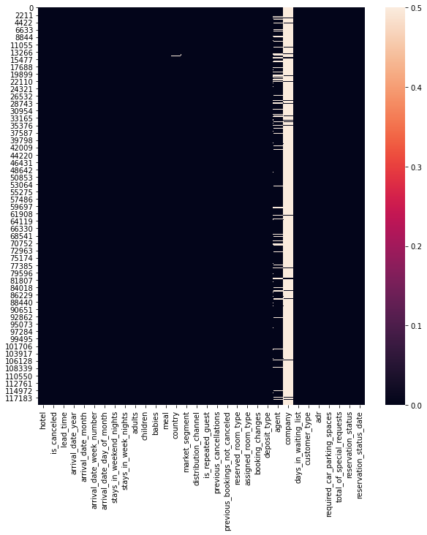
Exploratory Data Analysis – Missing Values
Company: 92%
Agent: 13%
Children: 0.003 %
Country: 0.41 %
Notes:
Consider talking about:
International luxury
Lifestyle luxury resorts
Upscale full-service
Boutique
Focused or select service
Economy and limited service
Extended stay
Timeshare and destination clubs
Motel
Microstay

Slide 6
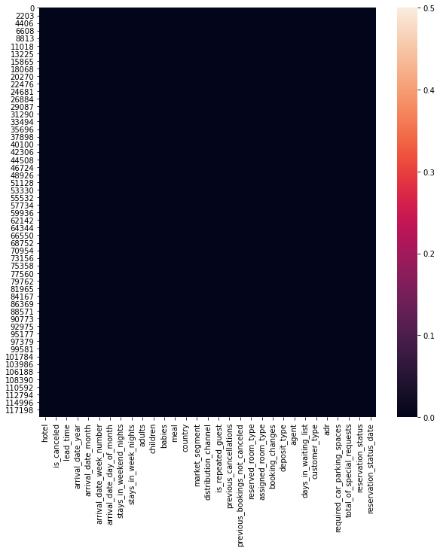
Exploratory Data Analysis – Missing Values
Notes:
Consider talking about:
International luxury
Lifestyle luxury resorts
Upscale full-service
Boutique
Focused or select service
Economy and limited service
Extended stay
Timeshare and destination clubs
Motel
Microstay

Slide 7
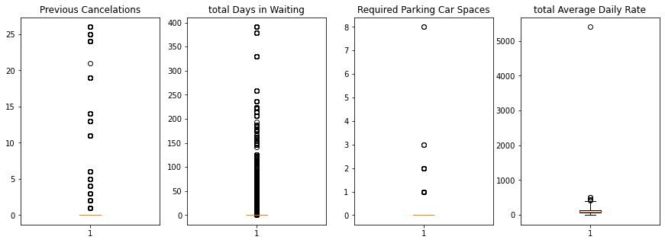
Exploratory Data Analysis – Outlier Detection
Notes:
Consider talking about:
International luxury
Lifestyle luxury resorts
Upscale full-service
Boutique
Focused or select service
Economy and limited service
Extended stay
Timeshare and destination clubs
Motel
Microstay

Slide 8
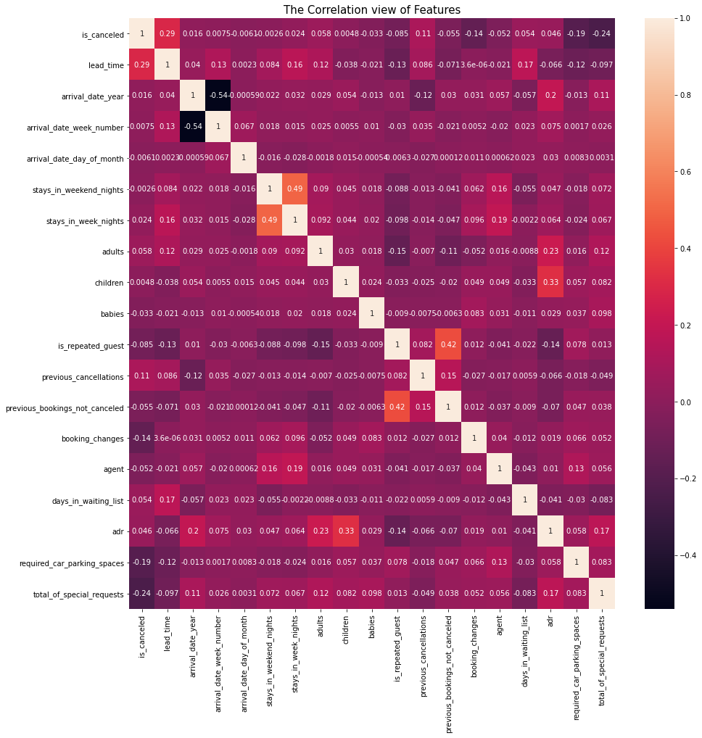
Exploratory Data Analysis – Correlation
Notes:
Consider talking about:
International luxury
Lifestyle luxury resorts
Upscale full-service
Boutique
Focused or select service
Economy and limited service
Extended stay
Timeshare and destination clubs
Motel
Microstay

Slide 9
Insights from Correlation
Feature | Correlation to ‘is_canceled’
Lead_time | .29
adr | .46
Days_in_waiting | 0.54
Total_of_special_request | -0.24
Is_repeated_guest | -0.085
Notes:
Consider talking about:
International luxury
Lifestyle luxury resorts
Upscale full-service
Boutique
Focused or select service
Economy and limited service
Extended stay
Timeshare and destination clubs
Motel
Microstay

Slide 10
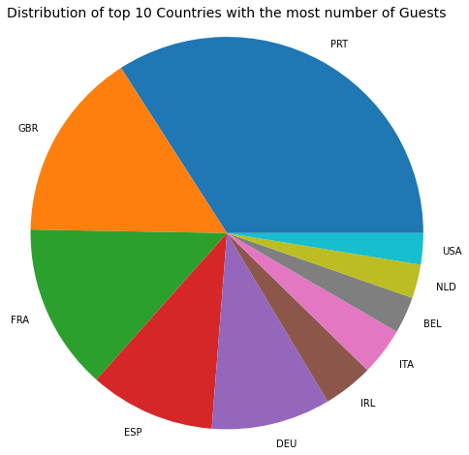
Exploratory Data Analysis – Countries
Portugal
Great Britain
France
Spain
Germany
Ireland
Italy
Belgium
The Netherlands
USA
Notes:
Consider talking about:
International luxury
Lifestyle luxury resorts
Upscale full-service
Boutique
Focused or select service
Economy and limited service
Extended stay
Timeshare and destination clubs
Motel
Microstay

Slide 11
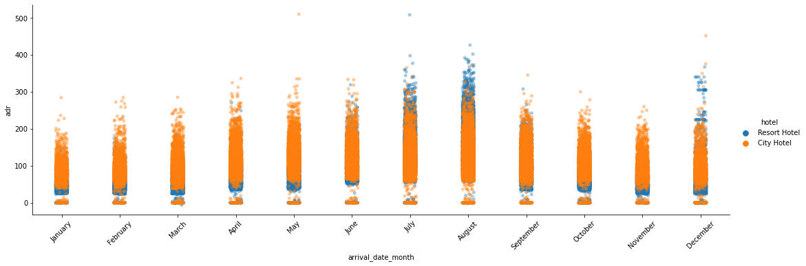
Exploratory Data Analysis – ADR for each month
Notes:
Consider talking about:
International luxury
Lifestyle luxury resorts
Upscale full-service
Boutique
Focused or select service
Economy and limited service
Extended stay
Timeshare and destination clubs
Motel
Microstay

Slide 12
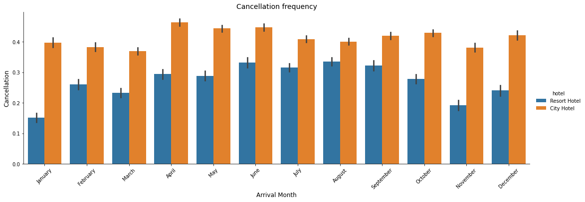
Exploratory Data Analysis – Cancelation frequency
Notes:
Consider talking about:
International luxury
Lifestyle luxury resorts
Upscale full-service
Boutique
Focused or select service
Economy and limited service
Extended stay
Timeshare and destination clubs
Motel
Microstay

Slide 13
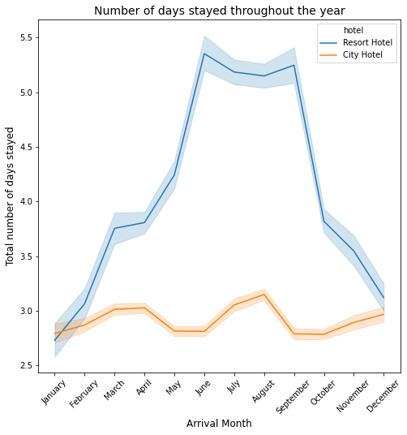
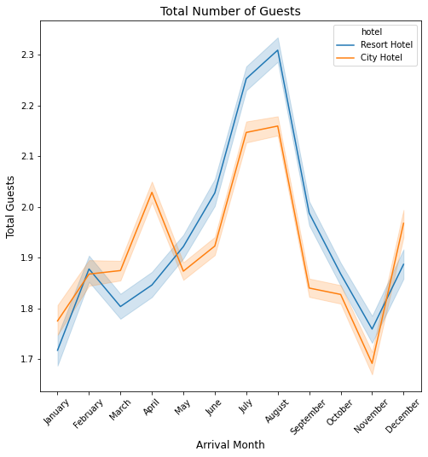
Seasonality
Notes:
Consider talking about:
International luxury
Lifestyle luxury resorts
Upscale full-service
Boutique
Focused or select service
Economy and limited service
Extended stay
Timeshare and destination clubs
Motel
Microstay

Slide 14
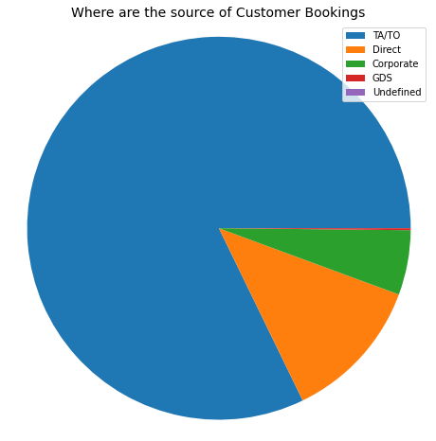
Exploratory Data Analysis – Source of bookings
Notes:
Consider talking about:
International luxury
Lifestyle luxury resorts
Upscale full-service
Boutique
Focused or select service
Economy and limited service
Extended stay
Timeshare and destination clubs
Motel
Microstay

Slide 15
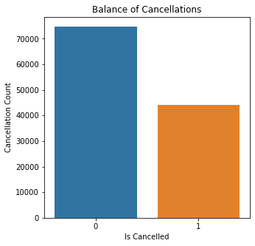
Exploratory Data Analysis – Target Variable
Notes:
Consider talking about:
International luxury
Lifestyle luxury resorts
Upscale full-service
Boutique
Focused or select service
Economy and limited service
Extended stay
Timeshare and destination clubs
Motel
Microstay

Slide 16
Preparing the dataset
Target feature: ‘is_canceled’
Processed Features:
'hotel’, 'customer_type', 'reserved_room_type', 'assigned_room_type’, 'country’, 'arrival_date_month’, 'market_segment’, 'distribution_channel’, 'meal’ ,'is_repeated_guest’, 'deposit_type’
..and all numerical
Train: 80%
Test: 20%
Notes:
Consider talking about:
International luxury
Lifestyle luxury resorts
Upscale full-service
Boutique
Focused or select service
Economy and limited service
Extended stay
Timeshare and destination clubs
Motel
Microstay

Slide 17
Model Selection
Model | Precision Score | Recall Score | Cross-Validation Mean Score
Logistic Regression | .79 | .58 | .79
Random Forest | .94 | .43 | .76
Balanced Random Forest | .76 | .70 | .79
Gradient Boosting | .84 | .75 | .86
XGBoost | .76 | .70 | .85
Notes:
Consider talking about:
International luxury
Lifestyle luxury resorts
Upscale full-service
Boutique
Focused or select service
Economy and limited service
Extended stay
Timeshare and destination clubs
Motel
Microstay

Slide 18
Confusion Matrix
Balanced Random Forest Enseble
12,994 | 1,955
2,688 | 6,143
Gradient Boosting
11,460 | 3,489
2,784 | 6,047
XGBoosting
13,714 | 1,235
2,170 | 6,661
Notes:
Consider talking about:
International luxury
Lifestyle luxury resorts
Upscale full-service
Boutique
Focused or select service
Economy and limited service
Extended stay
Timeshare and destination clubs
Motel
Microstay

Slide 19
Tuning the best Models / Best Results
Model | Previous Precision Score | Tuned Precision Score | Previous Recall Score | Tuned Recall Score | CV Score
Balanced Random Forest | .74 | .78 | .68 | .72 | .81
XGBoost | .74 | .85 | .68 | .79 | .85
Notes:
Consider talking about:
International luxury
Lifestyle luxury resorts
Upscale full-service
Boutique
Focused or select service
Economy and limited service
Extended stay
Timeshare and destination clubs
Motel
Microstay

Slide 20
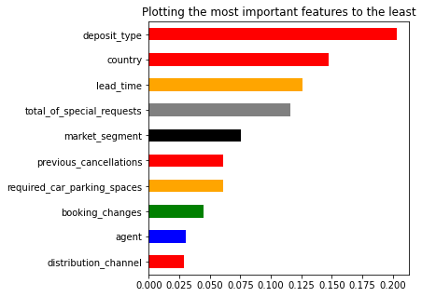
Feature Importance from the best models
Balanced Random Forest 10 Most Important Features
Notes:
Consider talking about:
International luxury
Lifestyle luxury resorts
Upscale full-service
Boutique
Focused or select service
Economy and limited service
Extended stay
Timeshare and destination clubs
Motel
Microstay

Slide 21
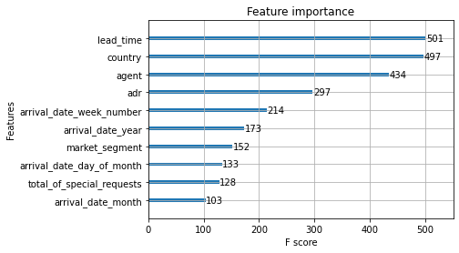
Feature Importance from the best models
Xboost 10 Most Important Features
Notes:
Consider talking about:
International luxury
Lifestyle luxury resorts
Upscale full-service
Boutique
Focused or select service
Economy and limited service
Extended stay
Timeshare and destination clubs
Motel
Microstay

Slide 22
Summary
New Insights
Completed the Research?
Implementable?
Notes:
Consider talking about:
International luxury
Lifestyle luxury resorts
Upscale full-service
Boutique
Focused or select service
Economy and limited service
Extended stay
Timeshare and destination clubs
Motel
Microstay

Slide 23
Future Considerations
Further research into class imbalance.
focus specifically certain counties.
Separate resort and city hotels
Separate the DATES and Years respectively
Time Series
Further experiments on feature selection
Notes:
Consider talking about:
International luxury
Lifestyle luxury resorts
Upscale full-service
Boutique
Focused or select service
Economy and limited service
Extended stay
Timeshare and destination clubs
Motel
Microstay

Slide 24
Target Audience
Decision Makers
Management
Consultants
Researchers
Notes:
Consider talking about:
International luxury
Lifestyle luxury resorts
Upscale full-service
Boutique
Focused or select service
Economy and limited service
Extended stay
Timeshare and destination clubs
Motel
Microstay

Slide 25
Questions ?
Notes:
Consider talking about:
International luxury
Lifestyle luxury resorts
Upscale full-service
Boutique
Focused or select service
Economy and limited service
Extended stay
Timeshare and destination clubs
Motel
Microstay

